Slide 1
SERIAL COMMUNICATION

Slide 2




BASICS OF SERIAL COMMUNICA- TION
Computers transfer data in two ways:
Parallel
Often 8 or more lines (wire conductors) are used to transfer data to a device that is only a few feet away
Serial
To transfer to a device located many meters away, the serial method is used
The data is sent one bit at a time
Serial Transfer Parallel Transfer
D0
Receiver
Sender
Sender
Receiver
D7

Slide 3
BASICS OF SERIAL COMMUNICA- TION
(cont’)
Transmitted through PISO
Receiving through SIPO
In telephone line data is modulated?
Modem(Modulator/demodulator)

Slide 4
BASICS OF SERIAL COMMUNICA- TION
(cont’)
Serial data communication uses two methods
Synchronous method (block)
Asynchronous method (Byte)
special IC chips
UART
USART

Slide 5










Transmission
BASICS OF SERIAL COMMUNICA- TION
Half- and Full- Duplex Transmission
Simplex
Transmitter
Receiver
Transmitter
Receiver
Half Duplex
Receiver
Transmitter
Transmitter
Receiver
Full Duplex
Receiver
Transmitter

Slide 6
A protocol is a set of rules agreed by both the sender and receiver on
How the data is packed
How many bits constitute a character
When the data begins and ends
Asynchronous serial data communication
Each character is placed in between start and stop bits, this is called framing
Block-oriented data transfers use the synchronous method
The start bit is always one bit, but the stop bit can be one or two bits
BASICS OF SERIAL COMMUNICA- TION
Start and Stop Bits

Slide 7




The start bit is always a 0 (low) and the stop bit(s) is 1 (high)
BASICS OF SERIAL COMMUNICA- TION
ASCII character “A” (8-bit binary 0100 0001)
Start and Stop Bits
(cont’)
Stop Bit
0
0
Start Bit
Mark
Space
0
1
0
0
0
1
D7
D0
Goes out last
Goes out first
The 0 (low) is referred to as space
The transmission begins with a start bit followed by D0, the LSB, then the rest of the bits
When there is no transfer, the signal is 1 (high), which is referred to as mark
until MSB (D7), and finally, the one stop bit indicating the
end of the character

Slide 8
25% overhead, i.e. each 8-bit character with an extra 2 bits
Maintain data integrity,
the parity bit is added
UART chips allow programming of the parity bit for odd-, even-, and no-parity options
BASICS OF SERIAL COMMUNICA- TION
Start and Stop Bits
(cont’)

Slide 9
The rate of data transfer (bps)
baud rate
As far as the conductor the baud rate and bps are the same.
BASICS OF SERIAL COMMUNICA- TION
Data Transfer Rate

Slide 10
The data transfer rate of given computer system depends on communication ports incorporated into that system
IBM: 100 to 9600 bps
Pentium-based: 56K bps
In asynchronous serial data communication, the baud rate is limited to 100K bps
BASICS OF SERIAL COMMUNICA- TION
Data Transfer Rate (cont’)

Slide 11
An interfacing standard RS232 was set by the Electronics Industries Association (EIA) in 1960
In RS232, a 1 is represented by -3 ~ -25 V, while a 0 bit is +3 ~ +25 V, making -3 to
+3 undefined
BASICS OF SERIAL COMMUNICA- TION
RS232
Standards

Slide 12
8051
CONNECTION TO RS232
8051 has two pins that are used specifically for transferring and receiving data serially
These two pins are called TxD and RxD and are part of the port 3 group (P3.0 and P3.1)
These pins are TTL compatible; therefore, they require a line driver to make them RS232 compatible

Slide 13

SERIAL COMMUNICA- TION PROGRAMMING
To allow data transfer between the PC and an 8051 system without any error, we must make sure that the baud rate
of 8051 system matches the baud rate of the PC’s COM port
Hyperterminal function supports baud rates much higher than listed below
PC Baud Rates
110
150
300
600
1200
2400
4800
9600
19200
Baud rates supported by 486/Pentium IBM PC BIOS

Slide 14

SERIAL COMMUNICA- TION PROGRAMMING
(cont’)
Baud Rate | TH1 (Decimal) | TH1 (Hex)
9600 | -3 | FD
4800 | -6 | FA
2400 | -12 | F4
1200 | -24 | E8
TF is set to 1 every 12 ticks, so it functions as a frequency divider

Slide 15
SCON is an 8-bit register used to program the start bit, stop bit, and data bits of data framing, among other things
SERIAL COMMUNICA- TION PROGRAMMING
SM0 | SM1 | SM2 | REN | TB8 | RB8 | TI | RI
SCON Register
SM0 SCON.7 SM1 SCON.6 SM2 SCON.5 REN SCON.4
Serial port mode specifier Serial port mode specifier
Used for multiprocessor communication Set/cleared by software to enable/disable reception Not widely used
Not widely used
Transmit interrupt flag. Set by HW at the
begin of the stop bit mode 1. And cleared by SW Receive interrupt flag. Set by HW at the
begin of the stop bit mode 1. And cleared by SW
TB8 SCON.3 RB8 SCON.2 TI SCON.1
RI SCON.0
Note:
Make SM2, TB8, and RB8 =0

Slide 16

SM0, SM1
They determine the framing of data by specifying the number of bits per character, and the start and stop bits
SM0 SM1
0 0 Serial Mode 0
SERIAL COMMUNICA- TION PROGRAMMING
SCON Register
(cont’)
0 1
1 0
1 1
Serial Mode 1, 8-bit data, 1 stop bit, 1 start bit
Serial Mode 2
Only mode 1 is
Serial Mode 3
of interest to us
SM2
This enables the multiprocessing capability of the 8051

Slide 17
REN (receive enable)
It is a bit-adressable register
When it is high, it allows 8051 to receive data on RxD pin
If low, the receiver is disable
TI (transmit interrupt)
When 8051 finishes the transfer of 8-bit character
It raises TI flag to indicate that it is ready to transfer another byte
TI bit is raised at the beginning of the stop bit
RI (receive interrupt)
When 8051 receives data serially via RxD, it gets rid of the start and stop bits and places the byte in SBUF register
It raises the RI flag bit to indicate that a byte has been received and should be picked up before it is lost
RI is raised halfway through the stop bit
SERIAL COMMUNICA- TION PROGRAMMING
SCON Register
(cont’)

Slide 18
SERIAL COMMUNICA- TION PROGRAMMING
Write a program for the 8051 to transfer letter “A” serially at 4800 baud, continuously.
Solution:
MOV |  | TMOD,#20H | ;timer 1,mode 2(auto reload)
MOV |  | TH1,#-6 | ;4800 baud rate
MOV |  | SCON,#50H | ;8-bit, 1 stop, REN enabled
SETB |  | TR1 | ;start timer 1
AGAIN: | MOV | SBUF,#”A” | ;letter “A” to transfer
HERE: | JNB | TI,HERE | ;wait for the last bit
 | CLR | TI | ;clear TI for next char
 | SJMP | AGAIN | ;keep sending A
Programming Serial Data Transmitting (cont’)

Slide 19
In programming the 8051 to transfer character bytes serially
SERIAL COMMUNICA- TION PROGRAMMING
TMOD register is loaded with the value 20H, indicating the use of timer 1 in mode 2 (8-bit auto-reload) to set baud rate
The TH1 is loaded with one of the values to set baud rate for serial data transfer
The SCON register is loaded with the value 50H, indicating serial mode 1, where an 8- bit data is framed with start and stop bits
TR1 is set to 1 to start timer 1
TI is cleared by CLR TI instruction
The character byte to be transferred serially is written into SBUF register
The TI flag bit is monitored with the use of instruction JNB TI,xx to see if the character has been transferred completely
To transfer the next byte, go to step 5
Programming Serial Data Transmitting

Slide 20
SERIAL COMMUNICA- TION PROGRAMMING
Write a program for the 8051 to transfer “YES” serially at 9600 baud, 8-bit data, 1 stop bit, do this continuously
Solution:
MOV | TMOD,#20H | ;timer 1,mode 2(auto reload)
MOV | TH1,#-3 | ;9600 baud rate
MOV | SCON,#50H | ;8-bit, 1 stop, REN enabled
SETB | TR1 | ;start timer 1
Programming Serial Data Transmitting (cont’)
AGAIN: MOV A,#”Y”
ACALL TRANS MOV A,#”E”
;transfer “Y”
;transfer “E”
ACALL TRANS MOV A,#”S” ACALL TRANS SJMP AGAIN
;transfer “S”
;keep doing it
;serial data transfer subroutine
TRANS: MOV
SBUF,A JNB TI,HERE CLR TI
RET
;load SBUF
;wait for the last bit
;get ready for next byte
HERE:

Slide 21
Interrupt
An interrupt is an external or internal event that interrupts the microcontroller to inform it that a device needs its service
A single microcontroller can serve several devices by two ways Interrupts.
Whenever any device needs its service, the device notifies the microcontroller by sending it an interrupt signal
Upon receiving an interrupt signal, the microcontroller interrupts whatever it is doing and serves the device
The program which is associated with the interrupt is called the interrupt service routine (ISR) or interrupt handler.

Slide 22
Polling
The microcontroller continuously monitors the status of a given device
When the conditions met, it performs the service After that, it moves on to monitor the next device until every one is serviced.

Slide 23
Enabling and Disabling an Interrupt
Upon Reset, all the interrupts are disabled even if they are activated.
The interrupts must be enabled using software in order for
the microcontroller to respond to those interrupts.
IE (interrupt enable)
register is responsible for enabling and disabling the interrupt.
IE is a bitaddressable register.
Interrupt Enable Register
EA − Global enable/disable.
- − Undefined.
ET2 − Enable Timer 2 interrupt.
ES − Enable Serial port interrupt.
ET1 − Enable Timer 1 interrupt.
EX1 − Enable External 1 interrupt.
ET0 − Enable Timer 0 interrupt.
EX0 − Enable External 0 interrupt.
EA | - | ET2 | ES | ET1 | EX1 | ET0 | EX0

Slide 24
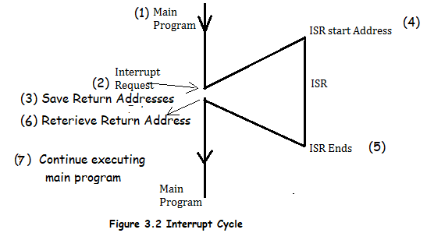
Interrupt service routine
For every interrupt, there must be an interrupt service routine (ISR), or interrupt handler
When an interrupt is invoked, the microcontroller runs the interrupt service Routine
For every interrupt, there is a fixed location in memory that holds the address of its ISR
The group of memory locations set aside to hold the addresses of ISRs is called interrupt vector table

Slide 25
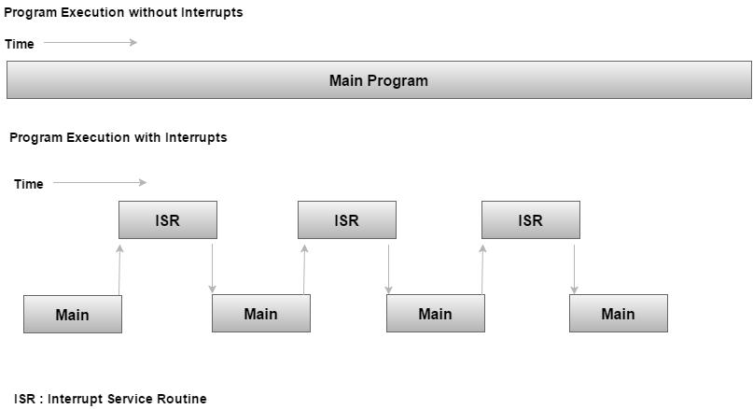
Interrupt service routine

Slide 26
Interrupt Vector Table
Six interrupts are allocated as follows
Reset – power-up reset
Two interrupts are set aside for the timers: one for timer 0 and one for timer 1
Two interrupts are set aside for hardware external interrupts
P3.2 and P3.3 are for the external hardware
interrupts INT0 (or EX1), and INT1 (or EX2)
Serial communication has a single interrupt that belongs to both receive and transfer
Interrupts | ROM Location (Hex) | Pin
Interrupts | ROM Location (HEX)
Serial COM (RI and TI) | 0023
Timer 1 interrupts(TF1) | 001B
External HW interrupt 1 (INT1) | 0013 | P3.3 (13)
External HW interrupt 0 (INT0) | 0003 | P3.2 (12)
Timer 0 (TF0) | 000B
Reset | 0000 | 9

Slide 27
Interrupt vector Table
When the reset pin is activated, the 8051 jumps to the address location 0000. This is power-up reset.
Two interrupts are set aside for the timers: one for timer 0 and one for timer 1. Memory locations are 000BH and 001BH respectively in the interrupt vector table.
Two interrupts are set aside for hardware external interrupts. Pin no. 12 and Pin no. 13 in Port 3 are for the external hardware interrupts INT0 and INT1, respectively. Memory locations are 0003H and 0013H respectively in the interrupt vector table.
Serial communication has a single interrupt that belongs to both receive and transmit. Memory location 0023H belongs to this interrupt.

Slide 28
Steps to Execute an Interrupt
The microcontroller closes the currently executing instruction and saves the address of the next instruction (PC) on the stack.
It also saves the current status of all the interrupts internally (i.e., not on the stack).
It jumps to the memory location of the interrupt vector table that holds the address of the interrupts service routine.
The microcontroller gets the address of the ISR from the interrupt vector table and jumps to it. It starts to execute the interrupt service subroutine, which is RETI (return from interrupt).
Upon executing the RETI instruction, the microcontroller returns to the location where it was interrupted. First, it gets the program counter (PC) address from the stack by popping the top bytes of the stack into the PC. Then, it start to execute from that address.

Slide 29
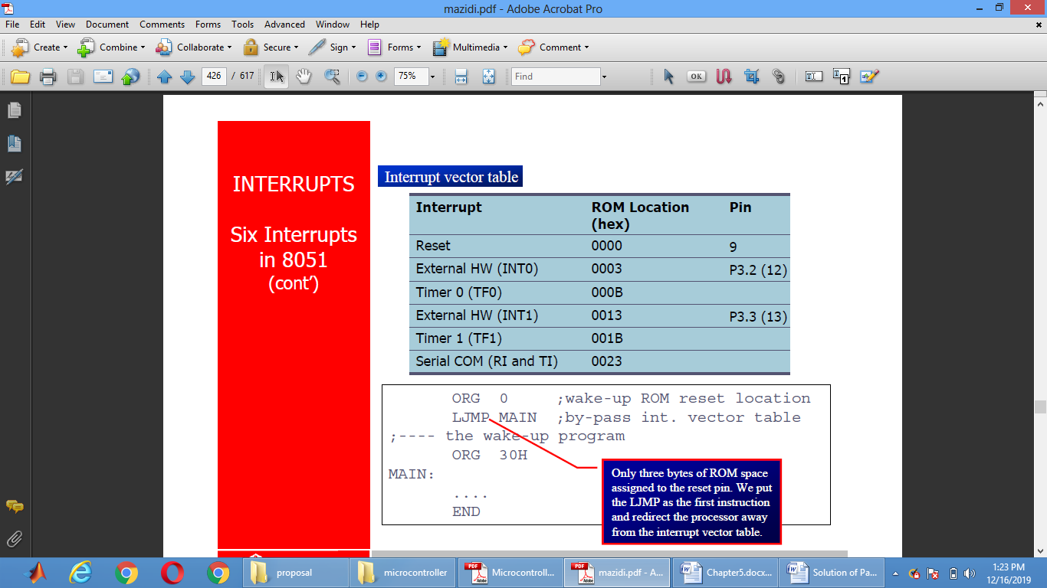

Slide 30
Interrupt priority
We can alter the interrupt priority by assigning the higher priority to any one of the interrupts. This is accomplished by programming a register called IP (interrupt priority).
- | IP.7 | Not Implemented.
- | IP.6 | Not Implemented.
- | IP.5 | Not Implemented.
- | IP.4 | Not Implemented.
PT1 | IP.3 | Defines the Timer 1 interrupt priority level.
PX1 | IP.2 | Defines the External Interrupt 1 priority level.
PT0 | IP.1 | Defines the Timer 0 interrupt priority level.
PX0 | IP.0 | Defines the External Interrupt 0 priority level.

Slide 31
#define LED_PIN 9
#define BUTTON_PIN 3
byte ledState = LOW;
void setup() {
pinMode(LED_PIN, OUTPUT);
pinMode(BUTTON_PIN, INPUT);
}
void loop() {
if (digitalRead(BUTTON_PIN), HIGH) {
ledState = !ledState;
}
digitalWrite(LED_PIN, ledState);
}

Slide 32
